Slide 1
Predicting Hydraulic Fracturing Induced Seismicity Magnitudes under Different Operational Conditions
TDI Capstone Project Proposal
Afshin Amini
July-26-2021

Slide 2
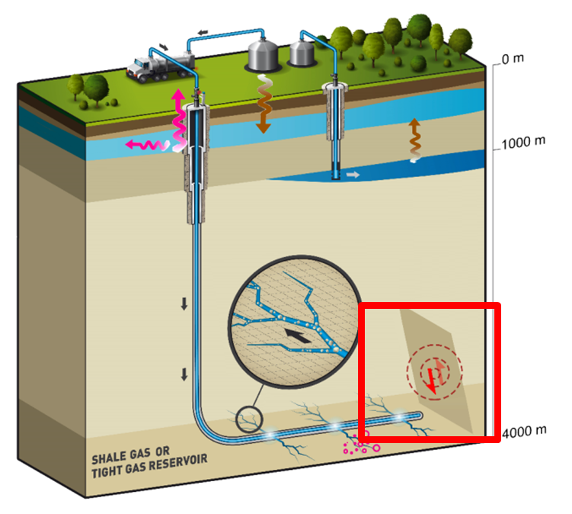
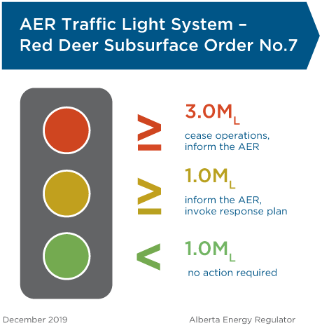
Who & Why
Oil & Gas Service Providers (Cost)
Oil & Gas Operators (Cost)
Energy Regulators (Guideline)
Cease Operations
$100.000 per day
Modify Operational Parameters
Delay Operations
(Additional costs)

Slide 3
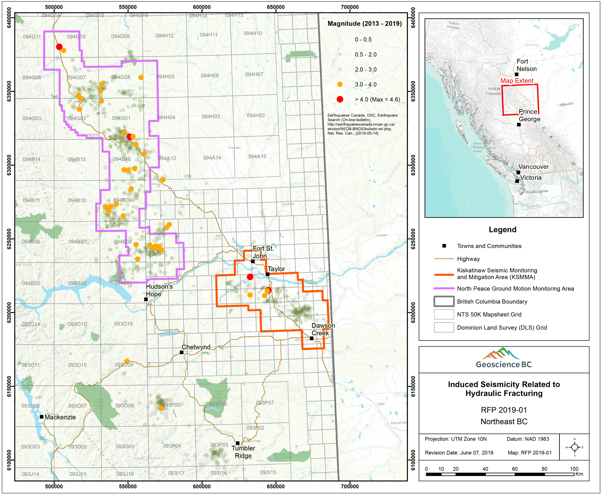
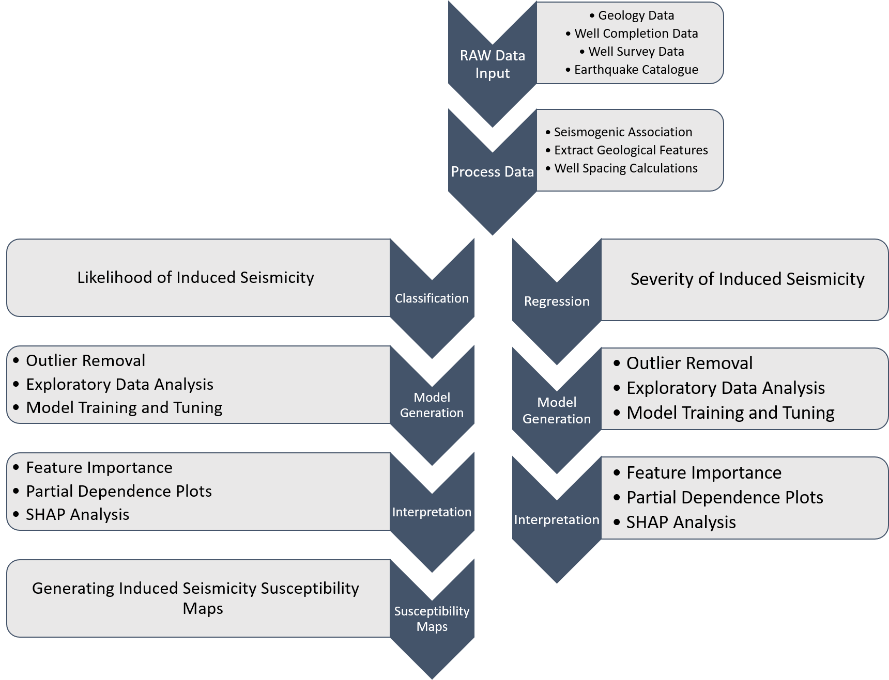
How: Building on previous work
Raw Data:
45 GB of Geological Data
100.000 Operational data
10.000 Earthquakes
Predict Magnitude under different operational conditions

Slide 4
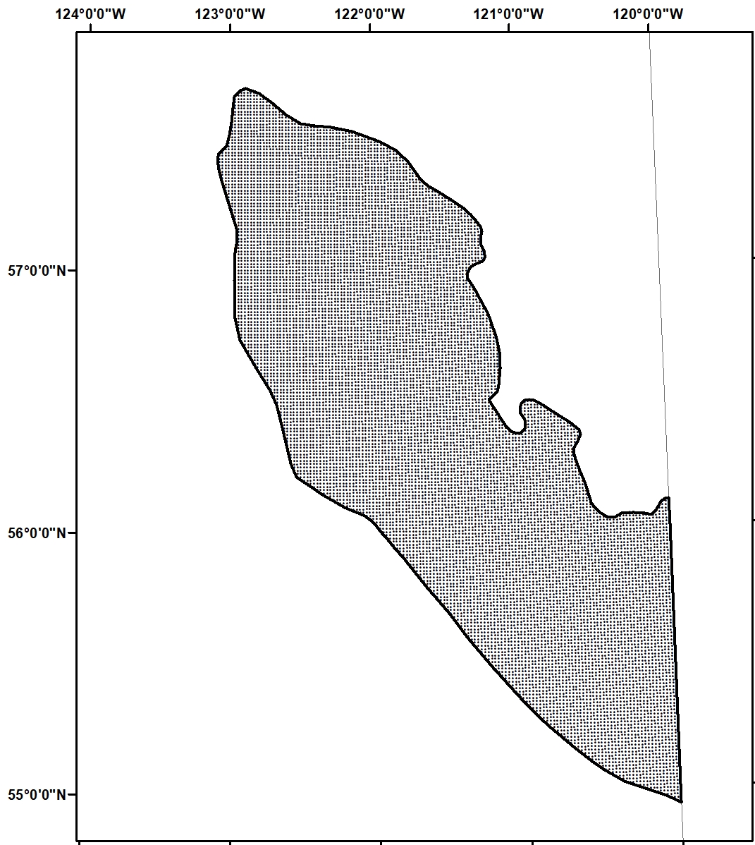
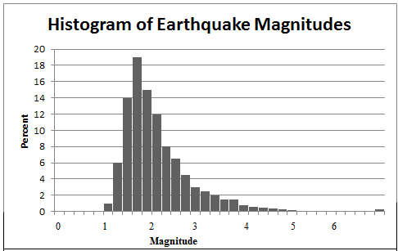
How: Dashboard
Tab 1
Tab 2
Information related to selected area:
Number of surrounding wells
Operational parameters
…
.

Slide 5
Thank You!

Slide 6
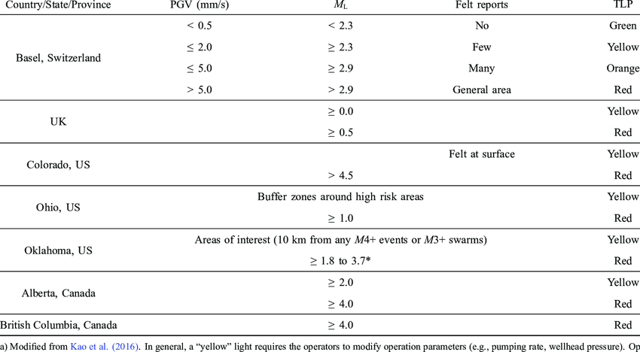
TLP in different countries

